Slide 1
DCIT 212 NUMERICAL AND COMPUTATIONAL METHODS
Session 5 – Nonlinear Equations - Part I
Lecturer: Justice K. Appati, PhD., UG, DCS
Contact Information: jkappati@ug.edu.gh

Slide 2
Course Information
Provide the following information:
Course Code: | DCIT 212
Course Title: | Numerical and Computational Methods
Course Credit | 3
Session Number & Session Title: | 5 & Nonlinear Equations - Part I
Semester/Year: | 2 / 2021

Slide 3
Course Information (contd.)
Provide the following information:
Lecture Period(s) | 2
Prerequisites | DCIT 105: Mathematics for IT Professionals
Teaching Assistant | TBD

Slide 4
Course Instructor’s Contact
Provide the following information:
Course Instructor(s) Name | Justice K. Appati, PhD.
Office Location | Stat 010, Statistics Building
Office Hours | TBD
Phone | N/A
E-mail | jkappati@ug.edu.gh

Slide 5
Session Overview
This session explore the general features of root finding. The interval halving and the false position method which constitute the close domain methods is discussed. The open domain methods such as fixed-point iteration, Newton and secant method is explored for root finding.

Slide 6
Session Outline
General Features of Root Finding
Interval Halving Method
False Position Method
Fixed Point Iteration
Newton’s Method
Secant Method

Slide 7
Learning Objectives
After completing this session, you will be able to:
Explain the general features of root finding.
Evaluate roots with Interval Halving method.
Evaluate roots with False Position method.
Evaluate roots with Fixe—Point iteration
Evaluate roots with Newtons & Secant method.

Slide 8
Session Activities and Assignments
This week, complete the following tasks:
Log onto the UG Sakai LMS course site: http://sakai.ug.edu.gh/
Read Chapter 3 (Pages 127 – 154) of Recommended Text – Joe D. Hoffman (2001), Numerical Methods for Engineers and Scientists (2nd Edition).
Review Lecture Slides: Session 5 – Nonlinear Equations - Part I
Visit the Chat Room and discuss the Forum question for Session 5
Complete the Individual Assignment for Session 5

Slide 9
Reading List
Read Chapter 3 (Pages 127 – 154) of Recommended Text – Joe D. Hoffman (2001), Numerical Methods for Engineers and Scientists (2nd Edition).

Slide 10
General Features of Root Finding
Topic One

Slide 11
Introduction
Solving for the zeros of an equation, a process known as root finding, is one of the oldest problems in mathematics.
There are two distinct phases in finding the roots of a nonlinear equation.
Bounding the solution
Refining the solution

Slide 12
Bounding the Solution
Bounding the solution involves finding a rough estimate of the solution that can be used as the initial approximation, or the starting point, in a systematic procedure that refines the solution to a specified tolerance in an efficient manner.
If possible, the root should be bracketed between two points at which the value of the nonlinear function has opposite signs.

Slide 13
Bounding the Solution
Several possible bounding procedures are:
Graphing the function
Incremental search
Past experience with the problem or similar problem
Solution of a simplified approximate model
Previous solution in a sequence of solutions

Slide 14
Bounding the Solution
Graphing the function: involves plotting the nonlinear function over the range of interest.
The resolution of the plots is generally not precise enough for an accurate result. However, the results are generally accurate enough to bound the solution.
Plots of a nonlinear function display the general behavior of the nonlinear equation and permit the anticipation of problems.

Slide 15
Bounding the Solution
Incremental Search: is conducted by starting at one end of the region of interest and evaluating the nonlinear function at small increments across the region.
When the value of the function changes sign, it is assumed that a root lies in that interval.
The two end end points of the interval containing the root can be used as initial guesses for a refining method

Slide 16
Bounding the Solution
Whatever procedure is used to bound the solution, the initial approximation must be sufficiently close to the exact solution to ensure
that the systematic refinement procedure converges
that the solution converges to the desired root of the nonlinear equation.

Slide 17
Bounding the Solution
Refining the solution: involves determining the solution to a specified tolerance by an efficient systematic procedure.
Several methods for refining the solution are:
Trial and error
Closed domain (bracketing) methods
Open domain methods

Slide 18
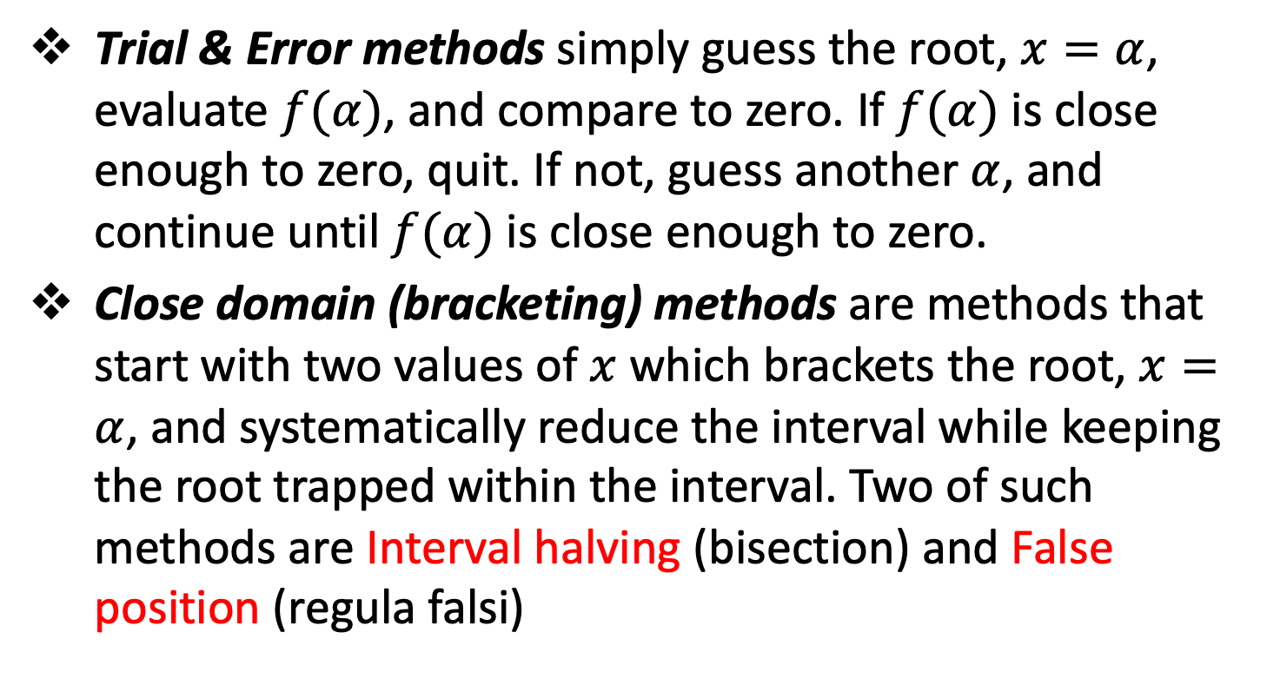
Bounding the Solution
Trial & Error methods simply guess the root, $x=α$, evaluate $f(α)$, and compare to zero. If $f(α)$ is close enough to zero, quit. If not, guess another $α$, and continue until $f(α)$ is close enough to zero.
Close domain (bracketing) methods are methods that start with two values of $x$ which brackets the root, $x=α$, and systematically reduce the interval while keeping the root trapped within the interval. Two of such methods are Interval halving (bisection) and False position (regula falsi)

Slide 19
Bounding the Solution
Open domain methods do not restrict the root to remain trapped in a closed interval.
Four open domain methods are:
The fixed-point iteration method
Newton’s method
The secant method
Muller’s method

Slide 20
Bounding the Solution
Merits:
The trial and error approach is totally unacceptable
Bracketing methods are robust in that they guaranteed to obtain a solution since the root is trapped in the closed interval. They can be slow to converge
Open domain are not robust as bracketing method and can diverge. However, they use information about the nonlinear function itself making it more efficient than bracketing methods.

Slide 21
Bounding the Solution
Behavior of Nonlinear Equations: Nonlinear equations can behave in various ways in the vicinity of a root.
Algebraic and transcendental equations may have distinct real roots, repeated real roots and complex root.
Polynomial may have real or complex root.
If the polynomial coefficients are ALL real, complex roots occurs in conjugate pairs.
If the polynomial coefficients are complex, single complex root can occur.

Slide 22
Close Domain (Bracketing) METHODS
Topic Two

Slide 23
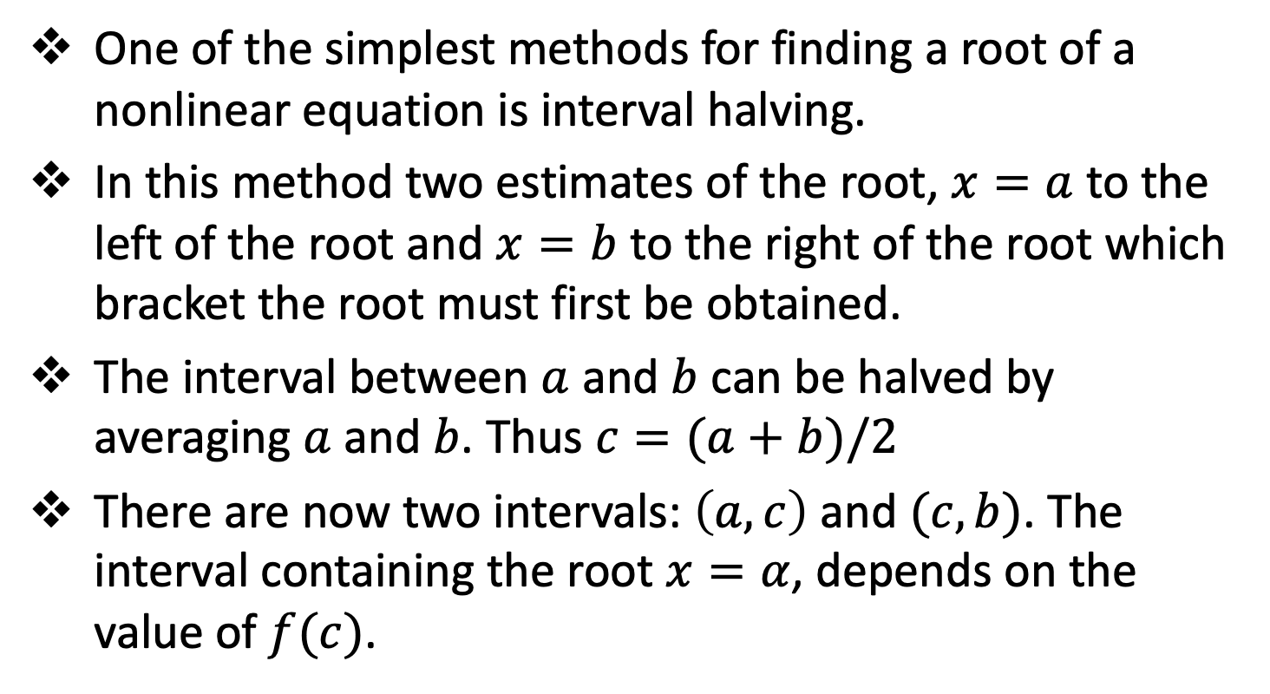
Interval Halving (Bisection)
One of the simplest methods for finding a root of a nonlinear equation is interval halving.
In this method two estimates of the root, $x=a$ to the left of the root and $x=b$ to the right of the root which bracket the root must first be obtained.
The interval between $a$ and $b$ can be halved by averaging $a$ and $b$. Thus $c=(a+b)/2$
There are now two intervals: $\left(a,c\right)$ and $(c,b)$. The interval containing the root $x=α$, depends on the value of $f(c)$.

Slide 24
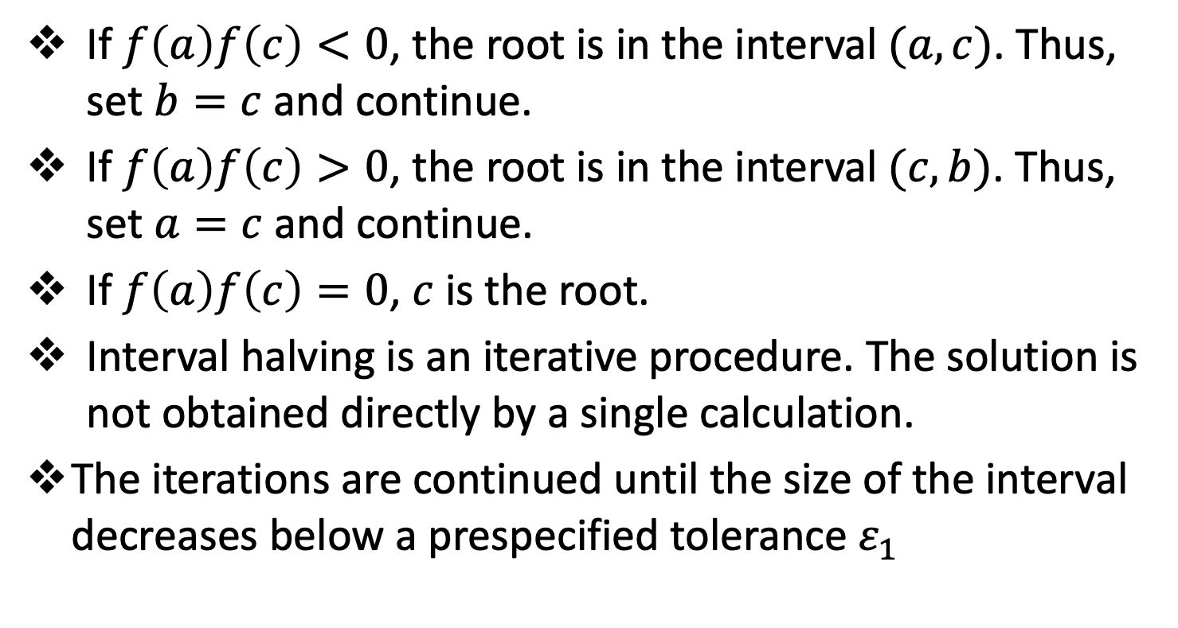
Interval Halving (Bisection)
If $f\left(a\right)f\left(c\right)<0$, the root is in the interval $(a,c)$. Thus, set $b=c$ and continue.
If $f\left(a\right)f\left(c\right)>0$, the root is in the interval $(c,b)$. Thus, set $a=c$ and continue.
If $f\left(a\right)f\left(c\right)=0$, $c$ is the root.
Interval halving is an iterative procedure. The solution is not obtained directly by a single calculation.
The iterations are continued until the size of the interval decreases below a prespecified tolerance $ε_{1}$

Slide 25
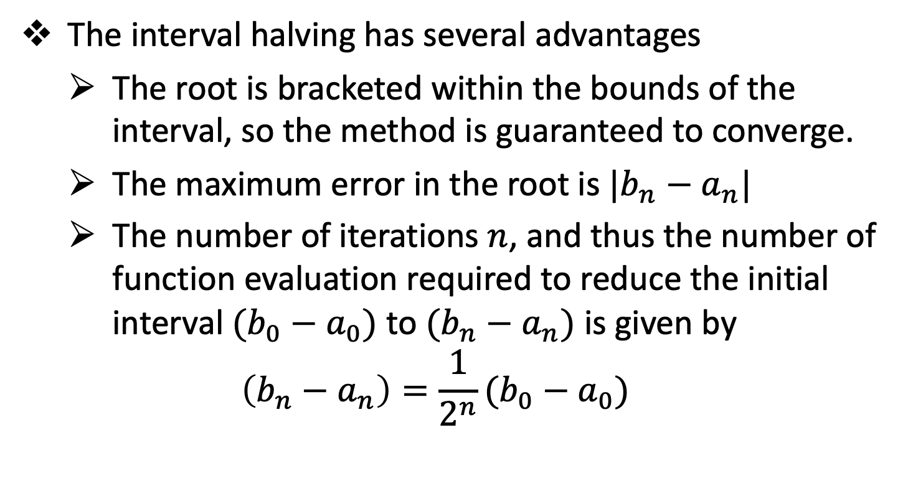
Interval Halving (Bisection)
The interval halving has several advantages
The root is bracketed within the bounds of the interval, so the method is guaranteed to converge.
The maximum error in the root is $|b_{n}−a_{n}|$
The number of iterations $n$, and thus the number of function evaluation required to reduce the initial interval $(b_{0}−a_{0})$ to $(b_{n}−a_{n})$ is given by
$$\left(b_{n}−a_{n}\right)=\frac{1}{2^{n}}(b_{0}−a_{0})$$

Slide 26
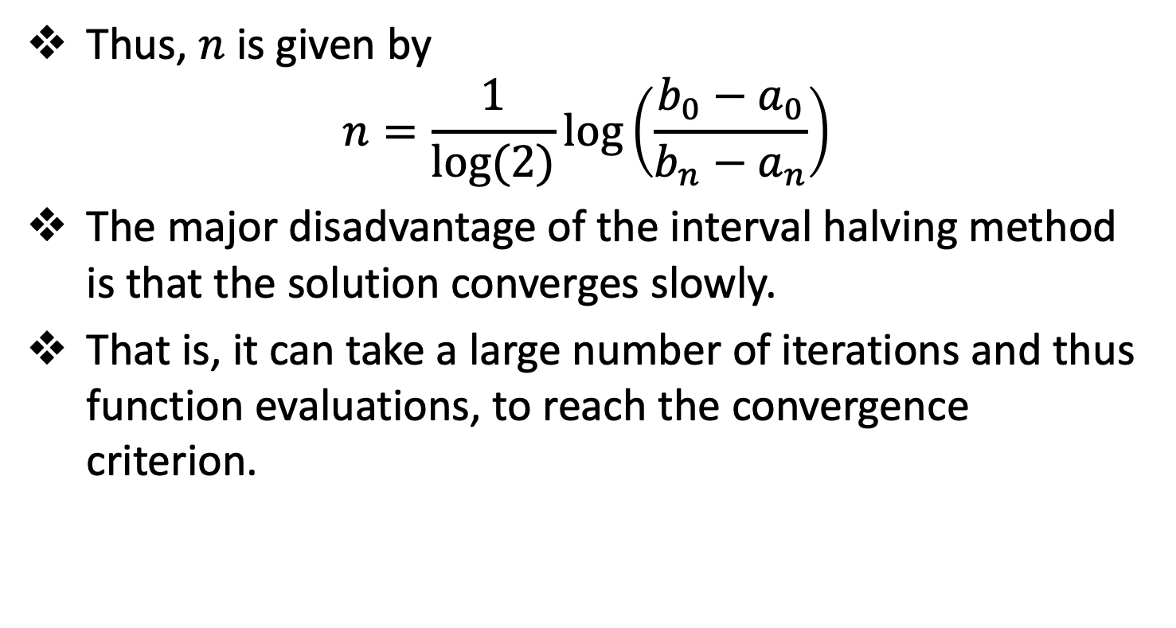
Interval Halving (Bisection)
Thus, $n$ is given by
$$n=\frac{1}{log⁡(2)}\log\left(\frac{b_{0}−a_{0}}{b_{n}−a_{n}}\right)$$
The major disadvantage of the interval halving method is that the solution converges slowly.
That is, it can take a large number of iterations and thus function evaluations, to reach the convergence criterion.

Slide 27
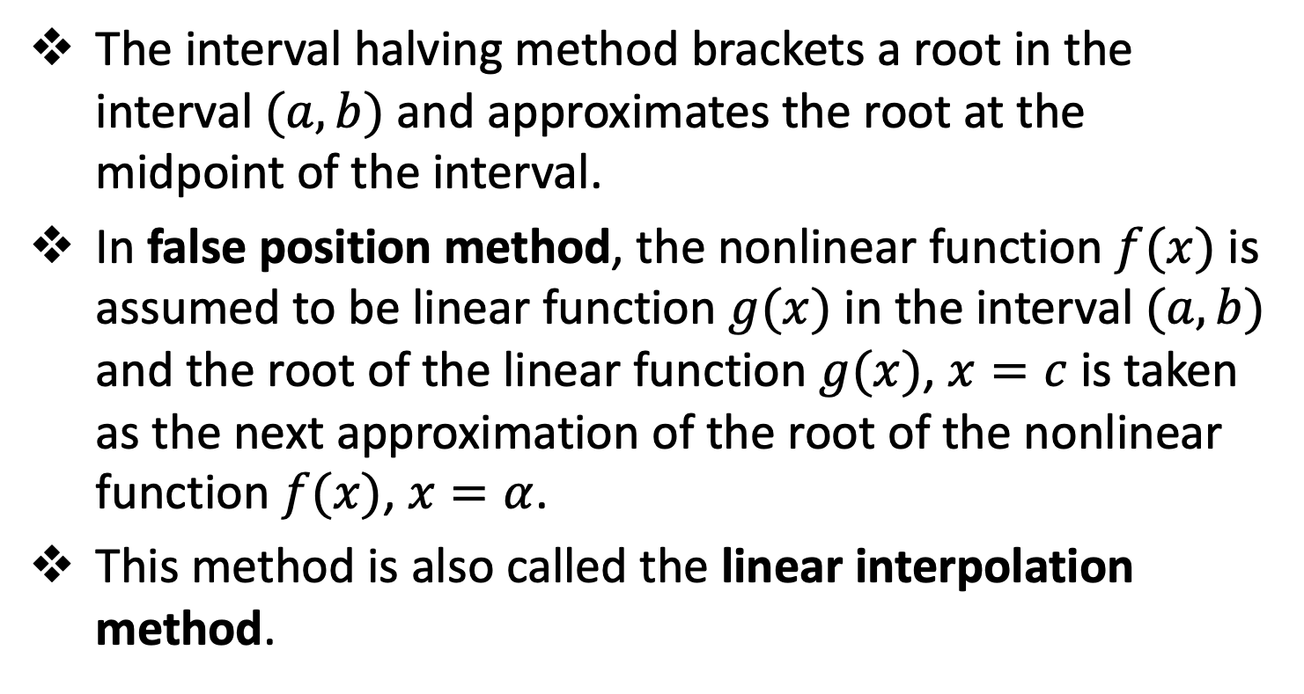
False Position (Regula Falsi)
The interval halving method brackets a root in the interval $(a,b)$ and approximates the root at the midpoint of the interval.
In false position method, the nonlinear function $f(x)$ is assumed to be linear function $g(x)$ in the interval $(a,b)$ and the root of the linear function $g(x)$, $x=c$ is taken as the next approximation of the root of the nonlinear function $f(x)$, $x=α$.
This method is also called the linear interpolation method.

Slide 28
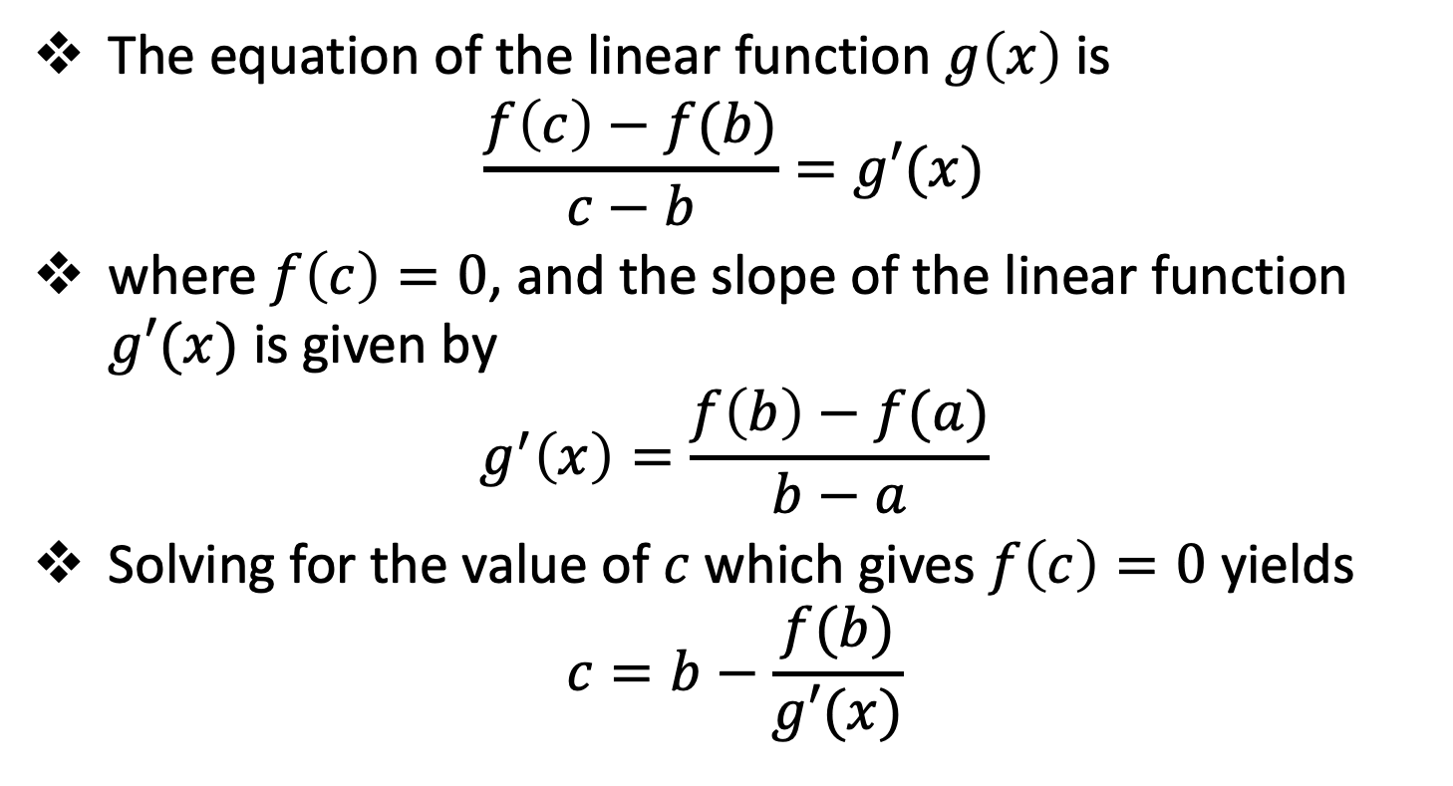
False Position (Regula Falsi)
The equation of the linear function $g\left(x\right)$ is
$$\frac{f\left(c\right)−f(b)}{c−b}=g′(x)$$
where $f\left(c\right)=0$, and the slope of the linear function $g′(x)$ is given by
$$g^{′}\left(x\right)=\frac{f\left(b\right)−f(a)}{b−a}$$
Solving for the value of $c$ which gives $f\left(c\right)=0$ yields
$$c=b−\frac{f(b)}{g′(x)}$$

Slide 29
Open Domain Methods
Topic Three

Slide 30
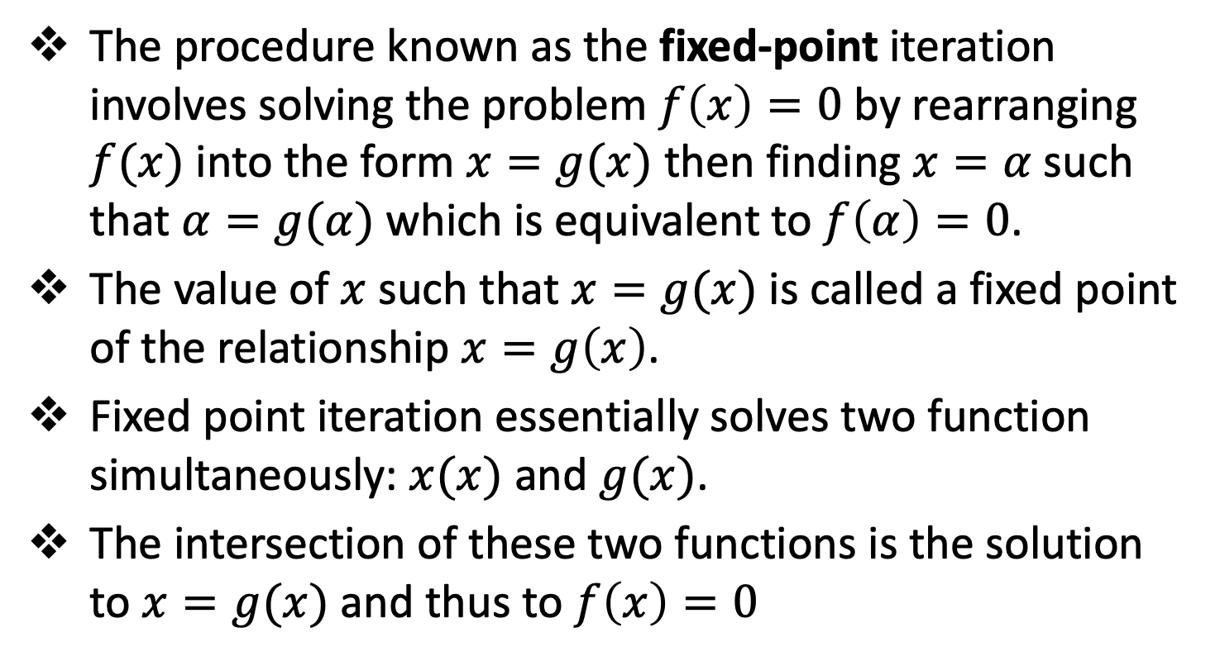
Fixed-Point Iteration
The procedure known as the fixed-point iteration involves solving the problem $f\left(x\right)=0$ by rearranging $f(x)$ into the form $x=g(x)$ then finding $x=α$ such that $α=g(α)$ which is equivalent to $f\left(α\right)=0$.
The value of $x$ such that $x=g(x)$ is called a fixed point of the relationship $x=g\left(x\right)$.
Fixed point iteration essentially solves two function simultaneously: $x(x)$ and $g(x)$.
The intersection of these two functions is the solution to $x=g(x)$ and thus to $f\left(x\right)=0$

Slide 31
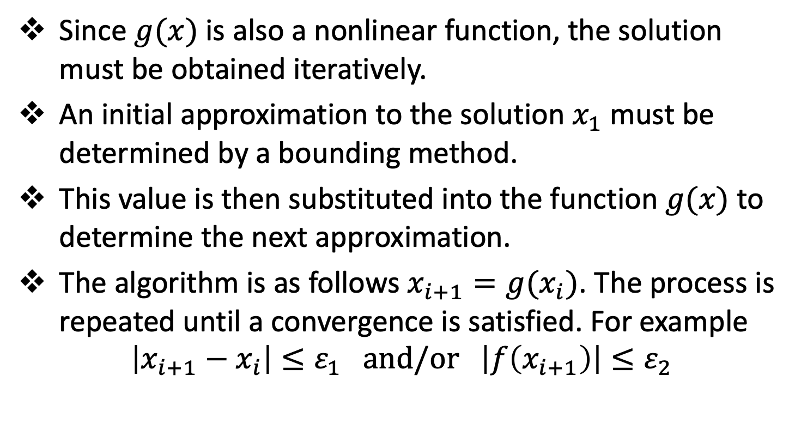
Fixed-Point Iteration
Since $g(x)$ is also a nonlinear function, the solution must be obtained iteratively.
An initial approximation to the solution $x_{1}$ must be determined by a bounding method.
This value is then substituted into the function $g(x)$ to determine the next approximation.
The algorithm is as follows $x_{i+1}=g(x_{i})$. The process is repeated until a convergence is satisfied. For example
$$\left|x_{i+1}−x_{i}\right|≤ε_{1} and/or \left|f\left(x_{i+1}\right)\right|≤ε_{2}$$

Slide 32
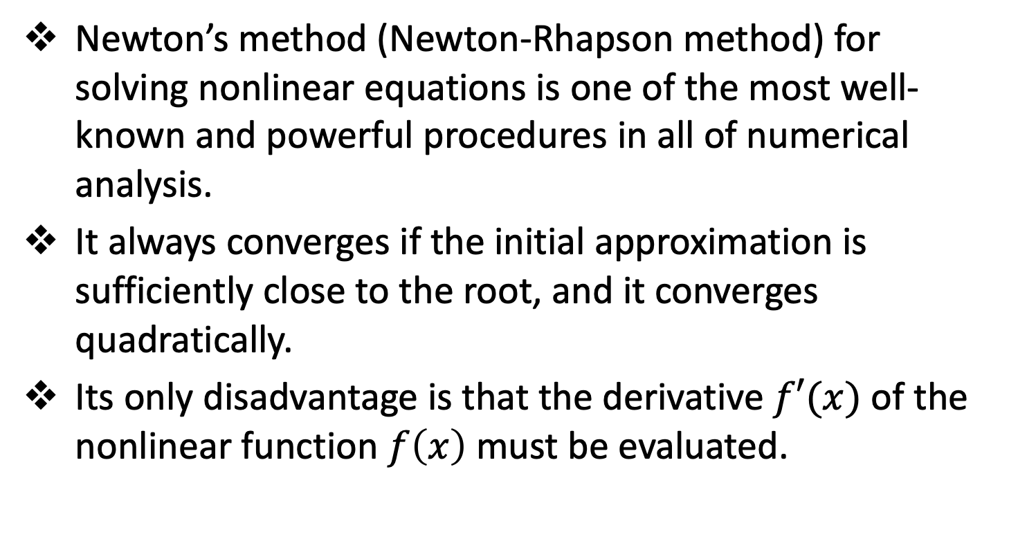
Newton’s Method
Newton’s method (Newton-Rhapson method) for solving nonlinear equations is one of the most well-known and powerful procedures in all of numerical analysis.
It always converges if the initial approximation is sufficiently close to the root, and it converges quadratically.
Its only disadvantage is that the derivative $f′(x)$ of the nonlinear function $f\left(x\right)$ must be evaluated.

Slide 33
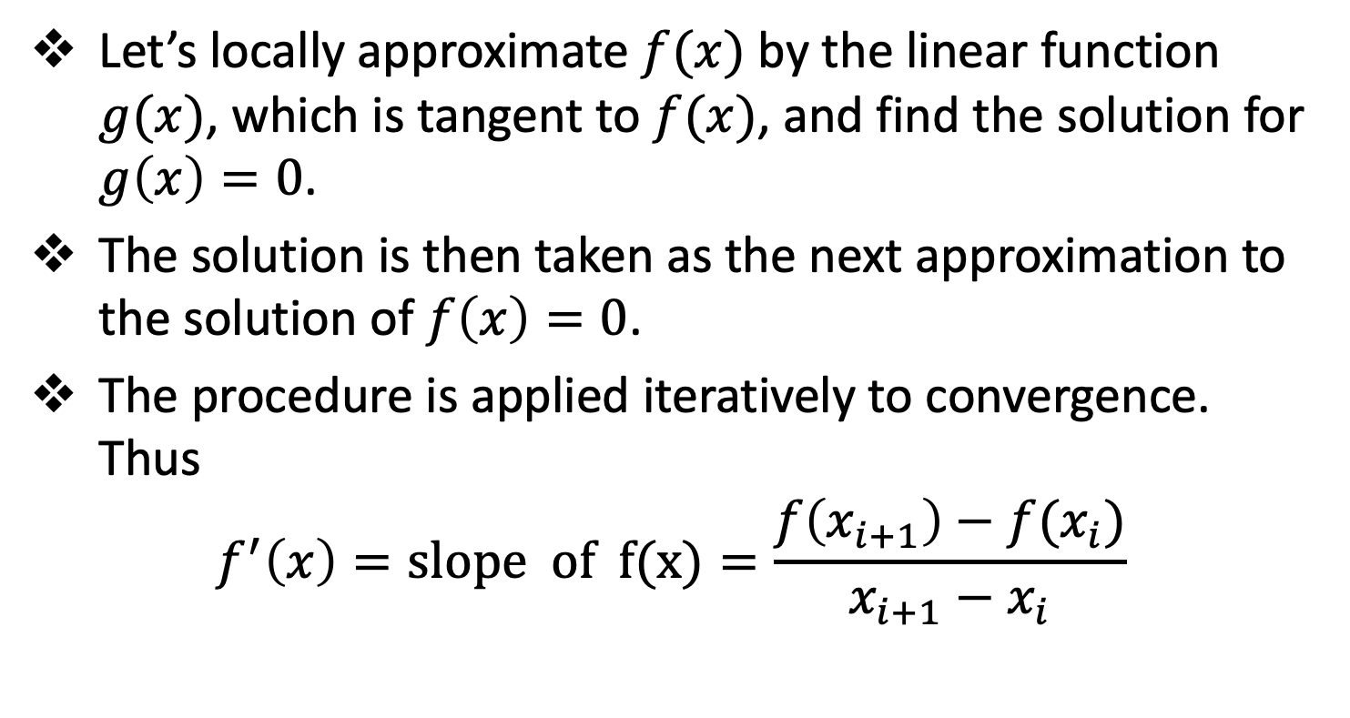
Newton’s Method
Let’s locally approximate $f(x)$ by the linear function $g(x)$, which is tangent to $f(x)$, and find the solution for $g\left(x\right)=0$.
The solution is then taken as the next approximation to the solution of $f\left(x\right)=0$.
The procedure is applied iteratively to convergence. Thus
$$f^{′}\left(x\right)=slope of f(x)=\frac{f\left(x_{i+1}\right)−f(x_{i})}{x_{i+1}−x_{i}}$$

Slide 34
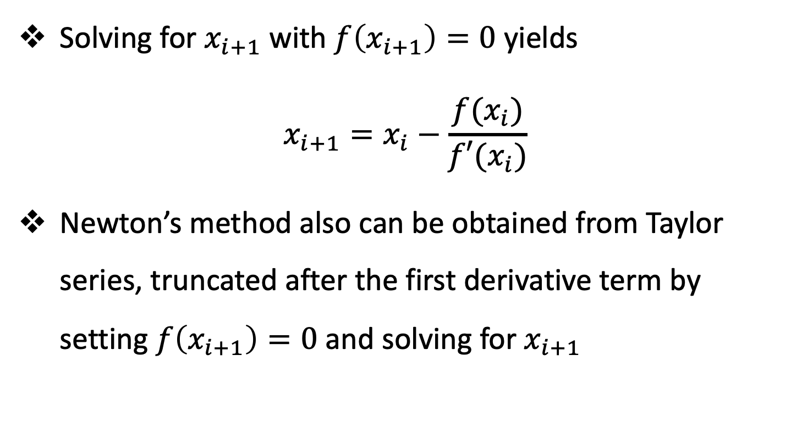
Newton’s Method
Solving for $x_{i+1}$ with $f\left(x_{i+1}\right)=0$ yields
$$x_{i+1}=x_{i}−\frac{f(x_{i})}{f′(x_{i})}$$
Newton’s method also can be obtained from Taylor series, truncated after the first derivative term by setting $f\left(x_{i+1}\right)=0$ and solving for $x_{i+1}$

Slide 35
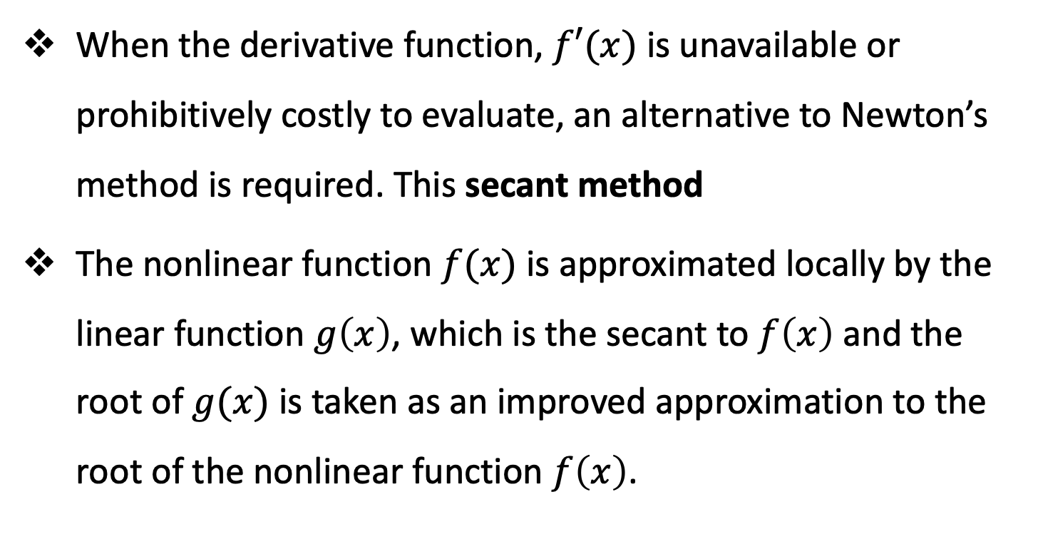
The Secant Method
When the derivative function, $f′(x)$ is unavailable or prohibitively costly to evaluate, an alternative to Newton’s method is required. This secant method
The nonlinear function $f(x)$ is approximated locally by the linear function $g\left(x\right)$, which is the secant to $f\left(x\right)$ and the root of $g(x)$ is taken as an improved approximation to the root of the nonlinear function $f\left(x\right)$.

Slide 36
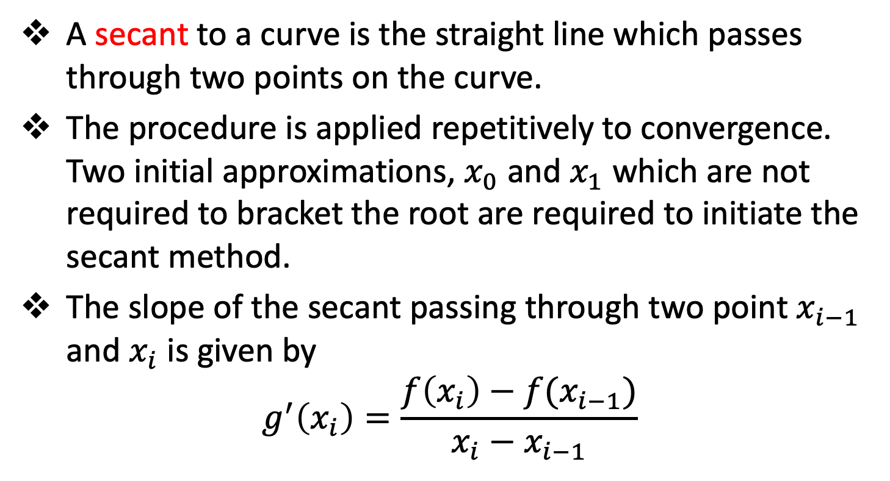
The Secant Method
A secant to a curve is the straight line which passes through two points on the curve.
The procedure is applied repetitively to convergence. Two initial approximations, $x_{0}$ and $x_{1}$ which are not required to bracket the root are required to initiate the secant method.
The slope of the secant passing through two point $x_{i−1}$ and $x_{i}$ is given by
$$g^{′}\left(x_{i}\right)=\frac{f\left(x_{i}\right)−f(x_{i−1})}{x_{i}−x_{i−1}}$$

Slide 37
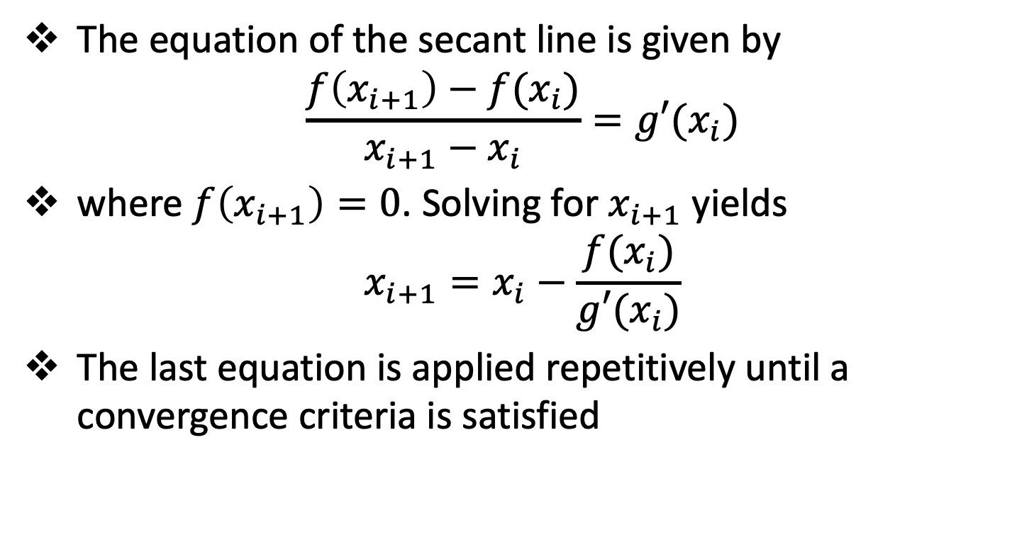
The Secant Method
The equation of the secant line is given by
$$\frac{f\left(x_{i+1}\right)−f(x_{i})}{x_{i+1}−x_{i}}=g′(x_{i})$$
where $f\left(x_{i+1}\right)=0$. Solving for $x_{i+1}$ yields
$$x_{i+1}=x_{i}−\frac{f(x_{i})}{g′(x_{i})}$$
The last equation is applied repetitively until a convergence criteria is satisfied

Slide 38
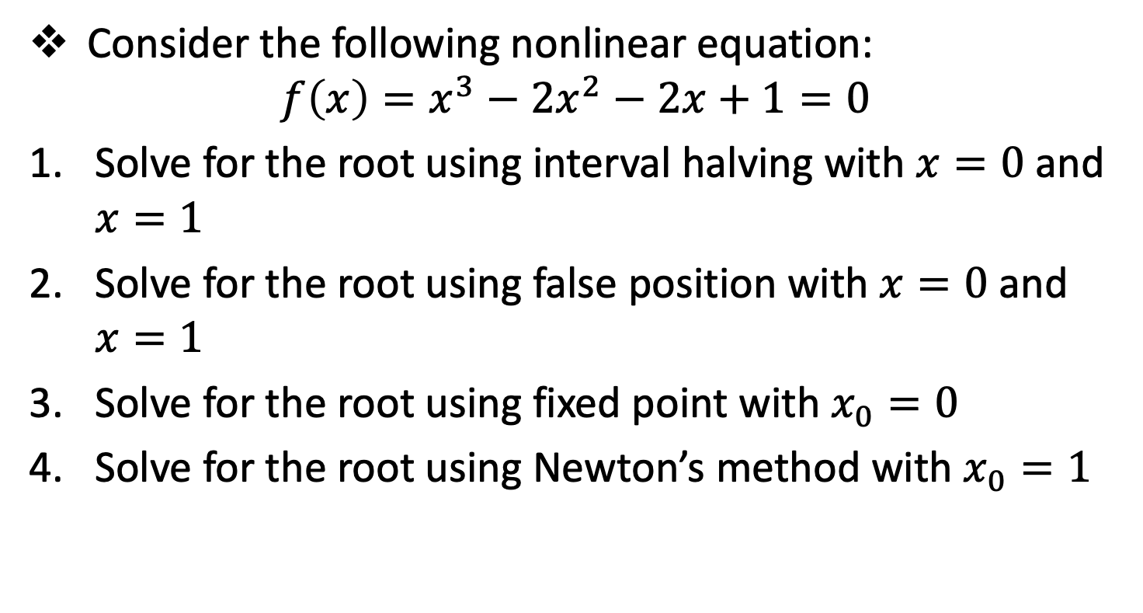
Session 5 - Assignment
Consider the following nonlinear equation:
$$f\left(x\right)=x^{3}−2x^{2}−2x+1=0$$
Solve for the root using interval halving with $x=0$ and $x=1$
Solve for the root using false position with $x=0$ and $x=1$
Solve for the root using fixed point with $x_{0}=0$
Solve for the root using Newton’s method with $x_{0}=1$

Slide 39
Reference
Hoffman, J. D. (2001), Numerical Methods for Engineers and Scientists (2nd Edition)
Johnston, R. L. (1982), Numerical Methods, A Software Approach, John Wiley & Sons
Kahaner, D., Moler, C., and Nash S. (1989), Numerical Methods and Software, Prentice Hall.

Slide 40
The End

